Slide 1
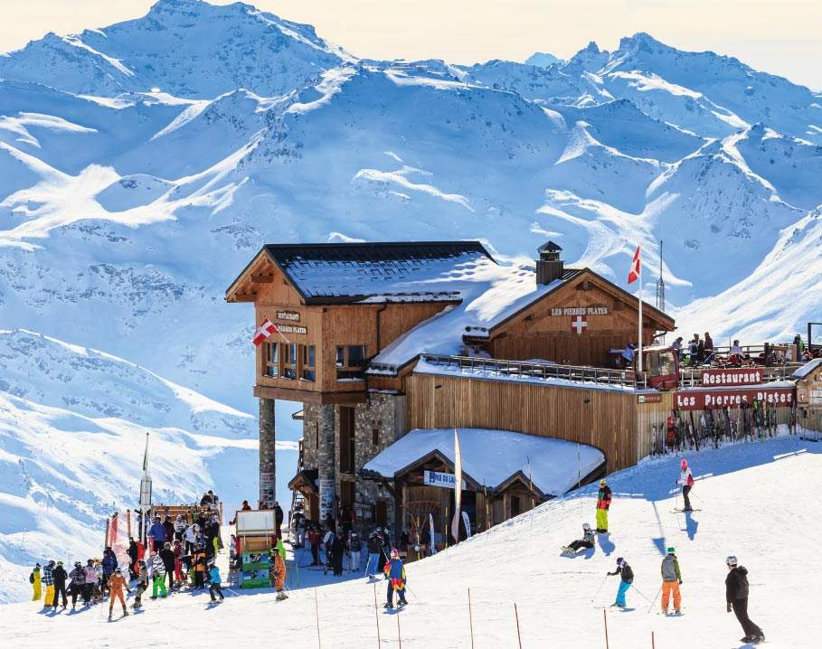

Guided Capstone Project
Big Mountain Resort Ticket Pricing Analysis and Recommendations
Picture Credit: https://www.europeanbestdestinations.com/best-of-europe/luxury-ski-resorts-in-europe/

Slide 2
Other Information
Big Mountain Ski Resort Basic Information
Name | Big Mountain Resort
Region | Montana
state | Montana
summit_elev | 6817
vertical_drop | 2353
base_elev | 4464
trams | 0
fastSixes | 0
fastQuads | 3
quad | 2
triple | 6
double | 0
surface | 3
total_chairs | 14
Runs | 105.0
TerrainParks | 4.0
LongestRun_mi | 3.3
SkiableTerrain_ac | 3000.0
Snow Making_ac | 600.0
daysOpenLastYear | 123.0
yearsOpen | 72.0
averageSnowfall | 333.0
AdultWeekend | 81.0
projectedDaysOpen | 123.0
NightSkiing_ac | 600.0
resorts_per_state | 12
state_population | 1068778
state_area_sq_miles | 147040
All-Level Skiing/Snowboarding Trails
Accommodations
350K Visitors / year
3 Fast Quads Lift
3,000 Acre Skiable Area
$81 per adult for weekend

Slide 3
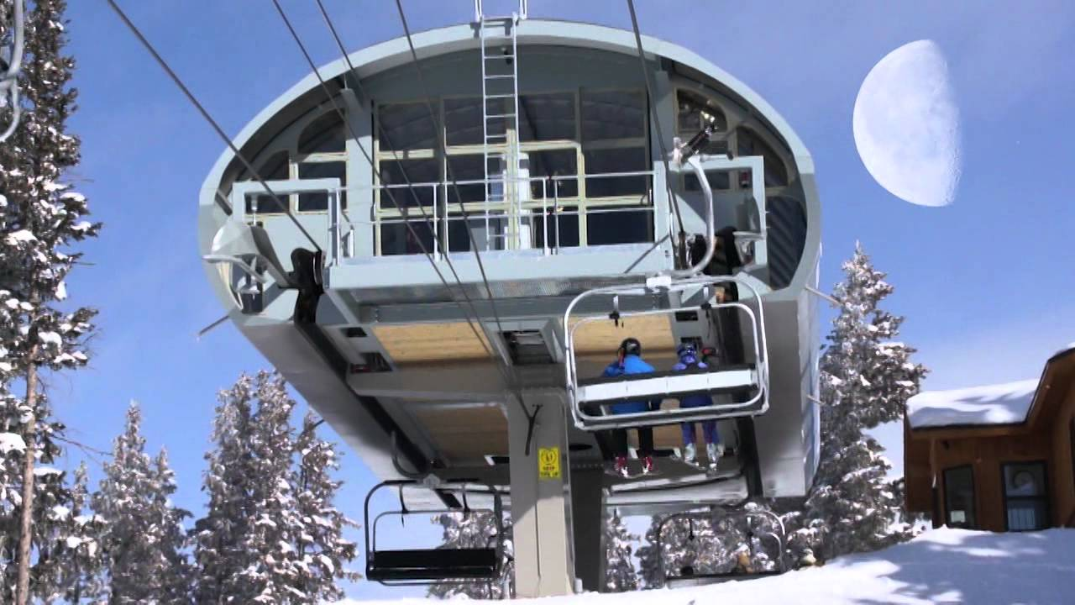
Objective of the Data Science Study
New Lift added $1.5M + Operational Cost
Remain Profitable?
Pic Credit: https://www.youtube.com/watch?v=c7d1UQGTpOM&ab_channel=InFilms%26Design

Slide 4
Key Findings
Big Mountain Ski Resort’s Ticket prices are among the higher tier in 277 studied resorts
Big Mountain Ski Resort’s equipment and properties are also in the range of higher tier of the 277 studied resorts
Snow making area, number of runs, number fastquads lifts, and vertical drops will positively affect the ticket price
These 4 are also the most important features that will affect the ticket price
The machine learning model suggested that the Big Mountain Ski Resort may qualify a higher lift ticket price

Slide 5
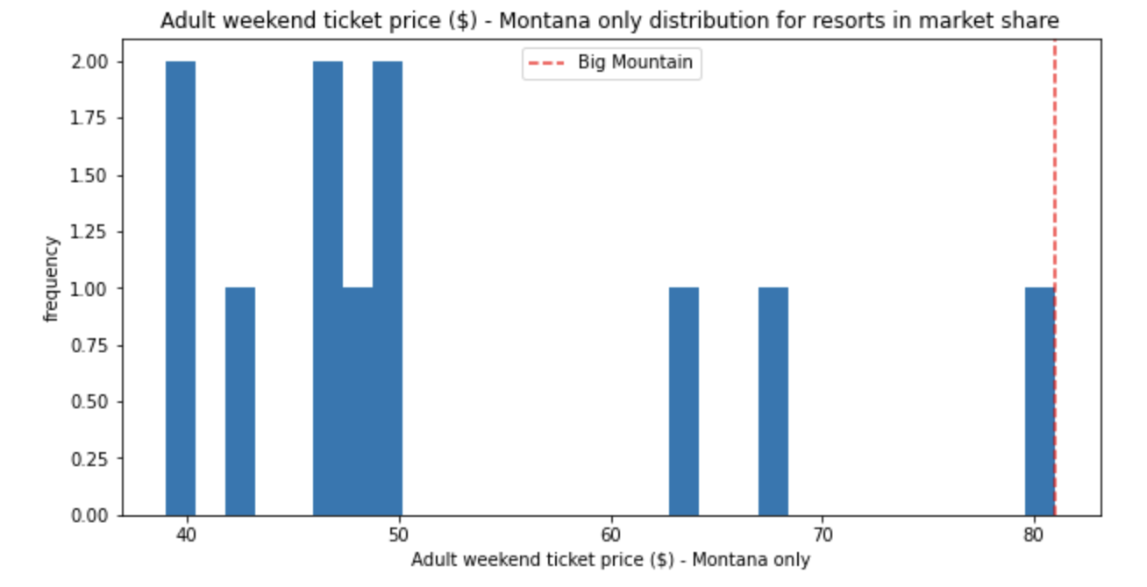
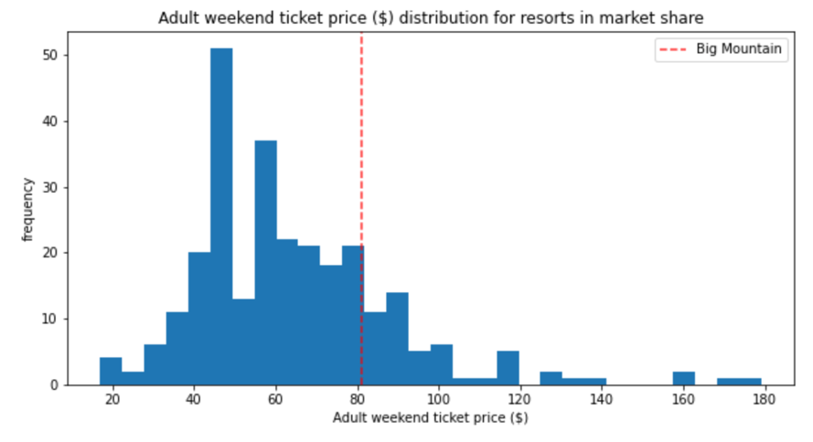
Observation 1
Current Ticket Price at Higher Tier Among 277 Resorts
It is also the highest in Montana

Slide 6
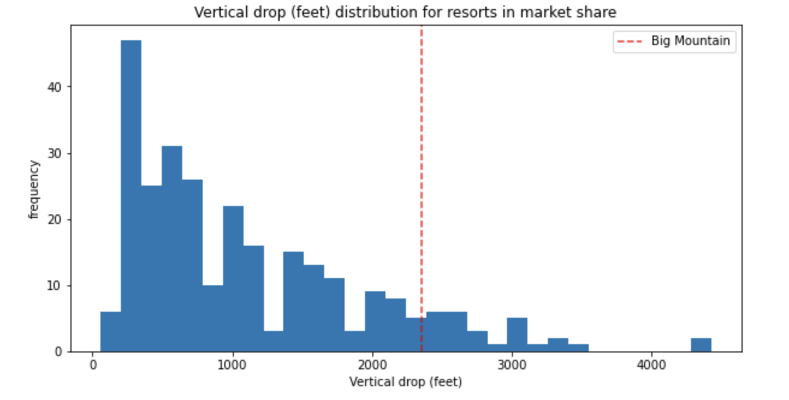
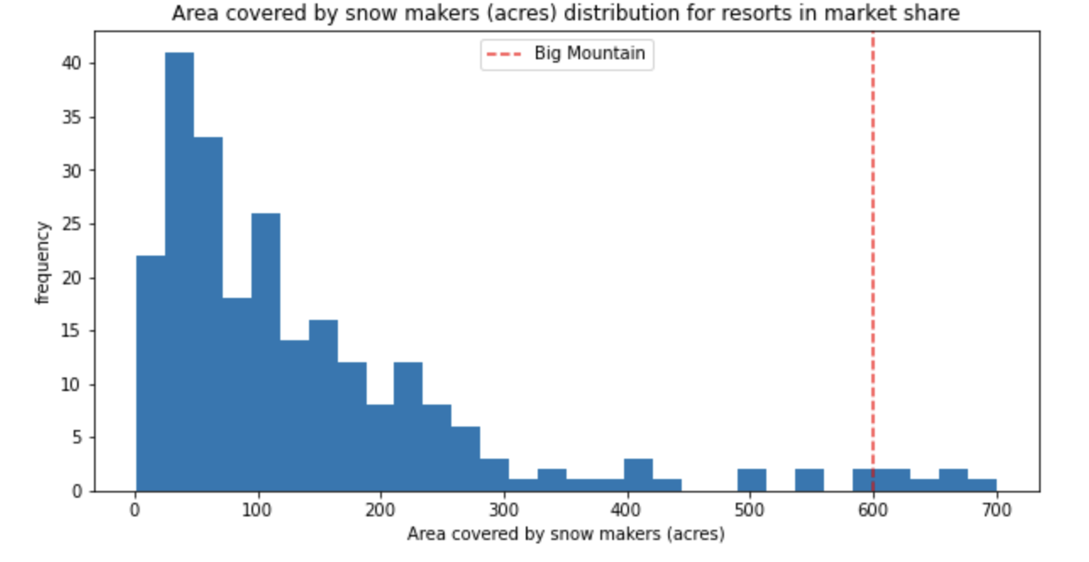
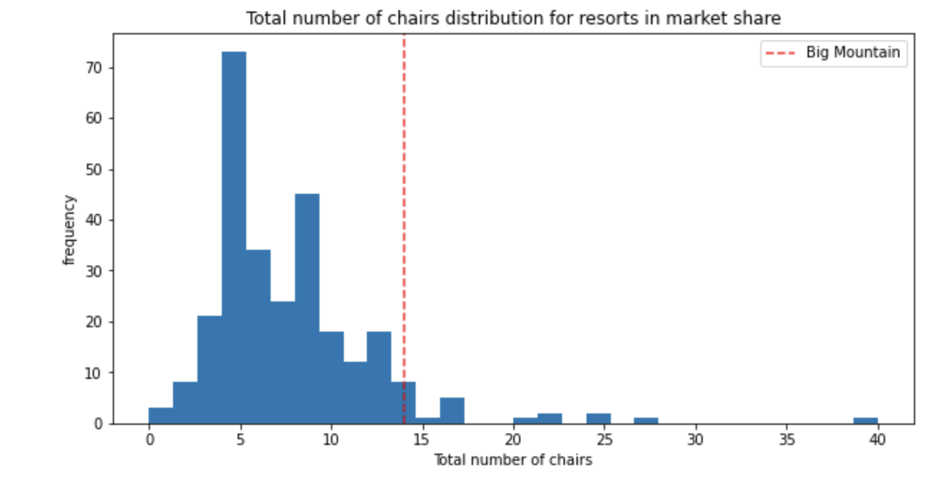
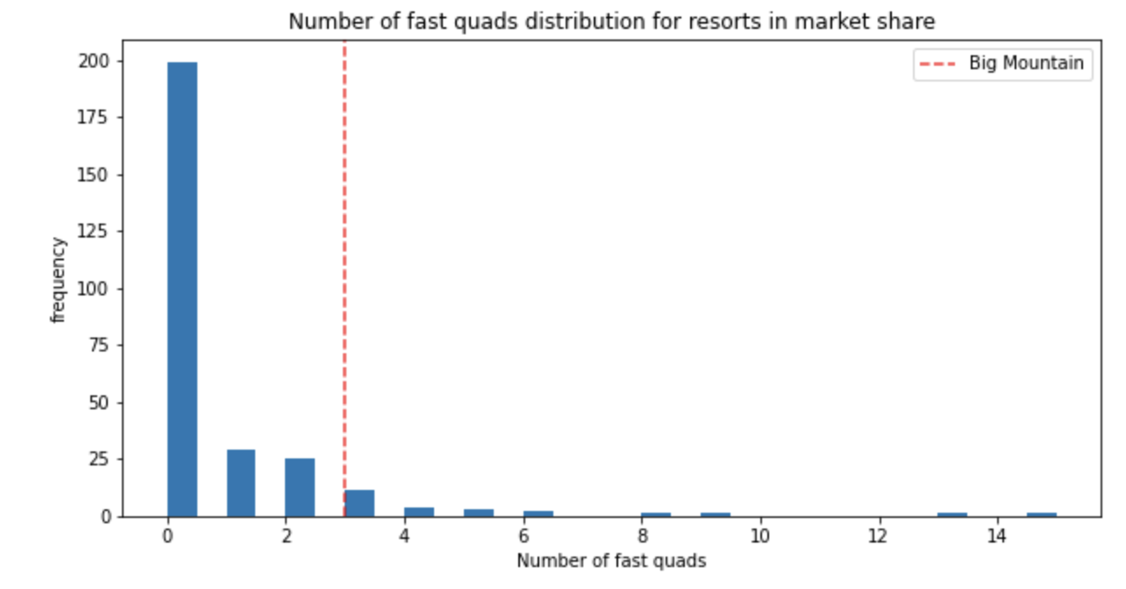
Observation 2
Big Mountain Ski Resort’s equipment and properties are also in the range of higher tier of the 277 studied resorts

Slide 7
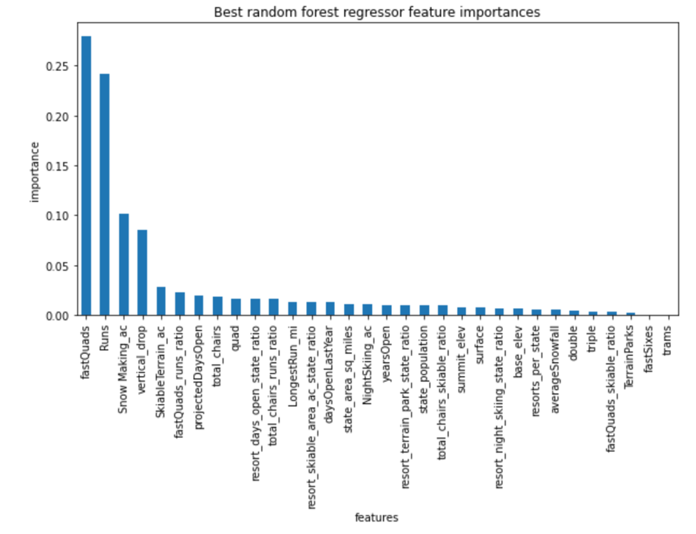
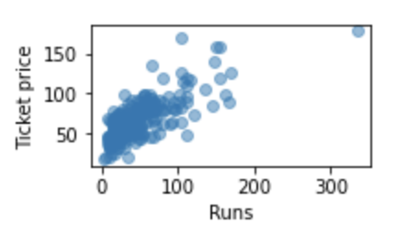
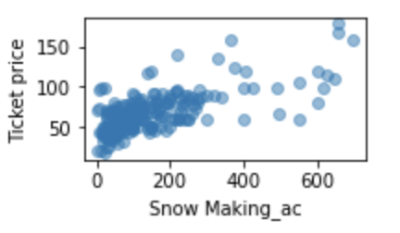
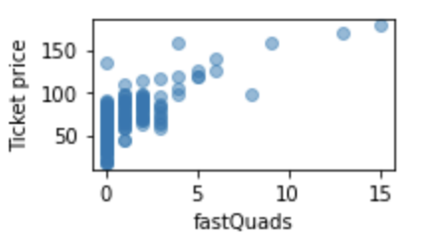
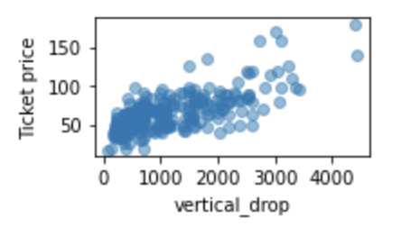
Observation 3
Snow making area, number of runs, number fastquads lifts, and vertical drops will positively affect the ticket price
These 4 are also the most important features that will affect the ticket price

Slide 8
Observation 4
Current Ticket Price:
$81
Modeled Ticket Price:
$96
Modeled Ticket Price Range
± $10
Random Forest Machine Learning Model was chosen, as it performed better than the Linear Regression Model
The model predicted that the Big Mountain Ski Resort may qualify a higher lift ticket price

Slide 9
1. May consider increase the ticket price
Even if the price increased to the lowest modeled price, the increased revenue will still cover the increased operational cost
2. Risk of increasing the price includes
Less visitors (as it is still the most expensive ski resort), which may also decrease the revenue
3. Next steps
Verify the accuracy of the database
Bring in more data, including the revenue from accommodations, merchandise and cost of operation to study the revenue of the resort as a whole
Recommendations

Slide 10
Questions?

